Slide 1



and the
The Magical Books
Idea by InYong Koo

Slide 2
STORY
Knowledge is Power, especially in KAIST. Treasure hunter
finds out that there are magical books at library that gives you special ability…
Survive the task and collect pages and artifacts !!
Explore the library! Find the magical books!!

Slide 3





User Interface
① Main Screen
② Achievements
Achievements
Artifact
Swipe to move
Description
Play
Achievements
Abilities
Help
③ Abilities
④ Help
132
Story
How to play
Description
Reset

Slide 4



User Interface
⑤ Game Screen
1
2
1:37
6

Slide 5
User Interface
⑤ Game Screen
1
2
1:37
6
Survival time
Abilities
Use ability 1/2 by pressing left/right side of the screen.
Pages
Current score
Character
Tilt the device to move character
Page
Generate on random location

Slide 6
User Interface
⑤ Game Screen - obstacles
1
2
1:37
6
Lava Puddle
after a warning, stays for a while
Boulder
Moves on one direction slowly
Dart
instant strike along the path
after a warning

Slide 7

User Interface
⑥ Death Screen
1
2
6
You Died
Best
Score
6
53
Time
1:37
6:28
Change
ability
Retry
Main
menu
New Achievement (if any)
New Achievement (if any)

Slide 8
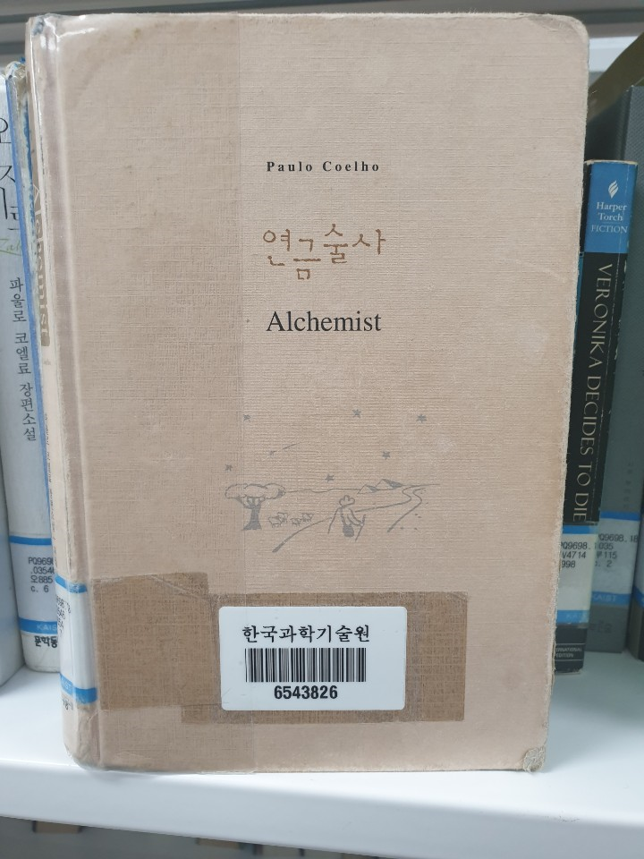
User Interface
⑦ Book Screen – Additional
Hmm… we have to Find “The Alchemist”
Find the magical book and Scan its barcode (Tag your phone)
Using Barcode or NFC API
Remaining hints: 5
Hint
Scan
(Tag)
Ex)
I think the book is on 4th Floor…
The book should be on bookshelf PQ.
The author of the book is Paulo Coelho.

Slide 9
Abilities
1. Alchemy
Book: The Alchemist – Paulo Coehlo
Remove all obstacles
2. Relativity
Book: The brief history of time – Stephen Hawking
Slow down the obstacles / better control for a brief time
3. Invincible
Book: Harry Potter and the philosopher’s stone – J.K. Rowling
Get Invincible for a brief time
and Etc…

Slide 10
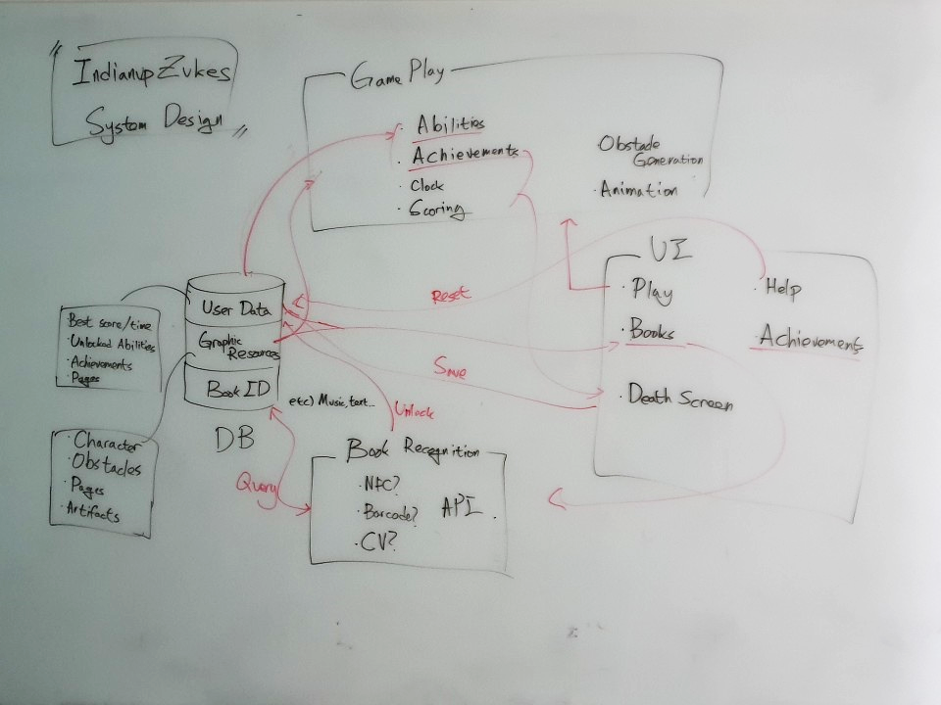
System Design

